Slide 1


2019 FIFA Women's World
Cup Matches
Presented by Sachleen Nahl
Tutorial Group - Thursday 1:30pm

Slide 2

Table of Contents
1
Introduction
2
Dataset Overview
3
Exploratory Data Analysis
4
Predictive Analysis
5
Implementation and Deployment
6
References

Slide 3

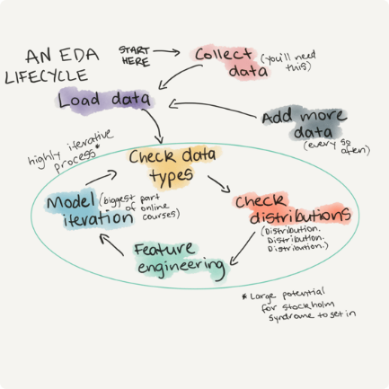


Introduction
Analysing the 2019 FIFA Women’s World Cup Matches dataset
Performing Exploratory Data Analysis and Predictive Analytics
Mass uncertainty and anticipation over which team will win was noticed and recognised as a problem

Slide 4

Exploratory Data Analysis

Slide 5

Date – Match Date
Leauge id
Leauge – League Played
Team 1
Team 2
Spi 1 – Team 1 Strength
Spi 2 – Team 2 Strength
Prob 1 – Team 1 Win Probability
Prob 2 –Team 2 Win Probability
Prob tie – Tie Probability
Proj score1 – Team 1 projected scores
Proj score2 – Team 2 projected scores
Score 1 – Team 1 Score
Score 2 – Team 2 Score
Xg 1 – Team 1 Expected Goals
Xg2 – Team 2 Expected Goals
Nsxg 1 – Team 1 Non-shot Expected Goals
Nsxg 2 – Team 2 Non-shot Expected Goals
Adj score 1 – Team 1 Adjusted Score
Adj score 2 – Team 2 Adjusted Score

Slide 6
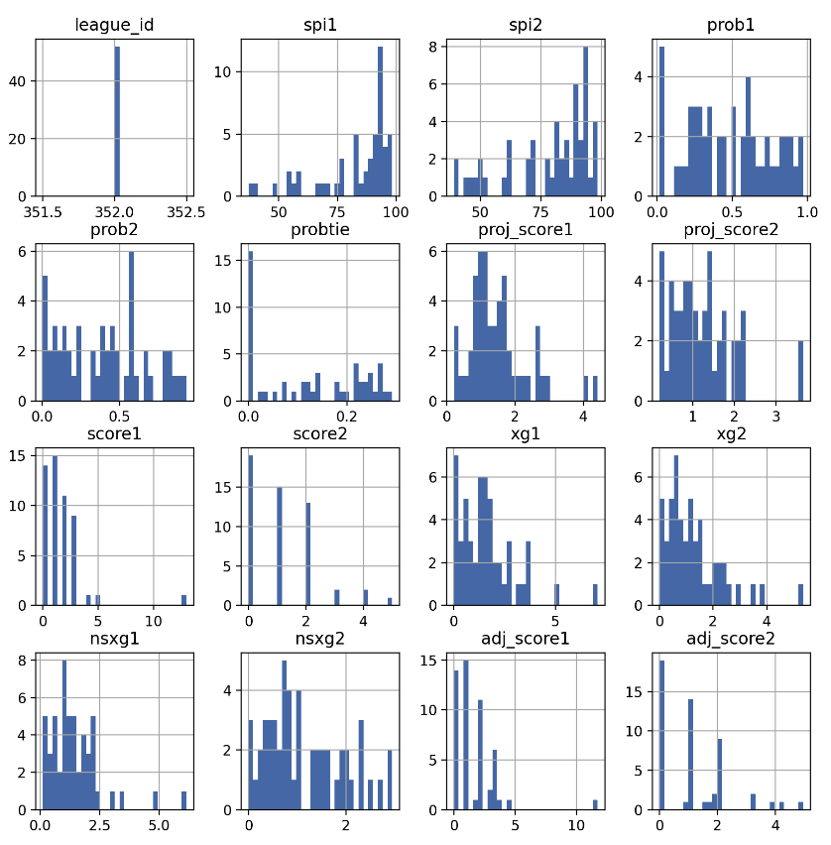
Value
Distribution

Slide 7
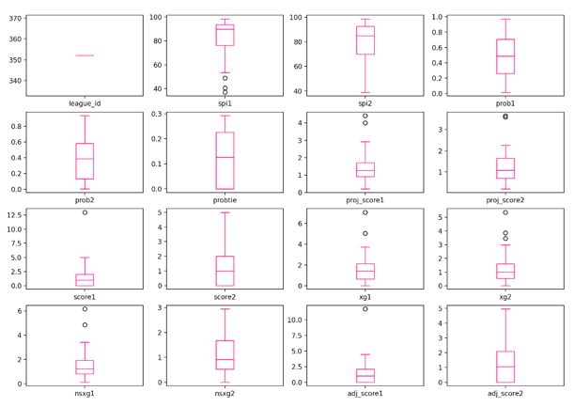
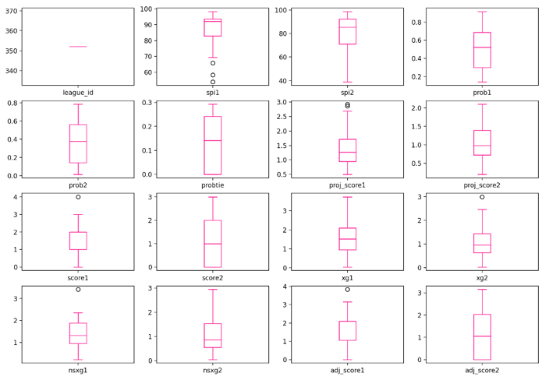
Outlier Detection
Outlier Removal

Slide 8
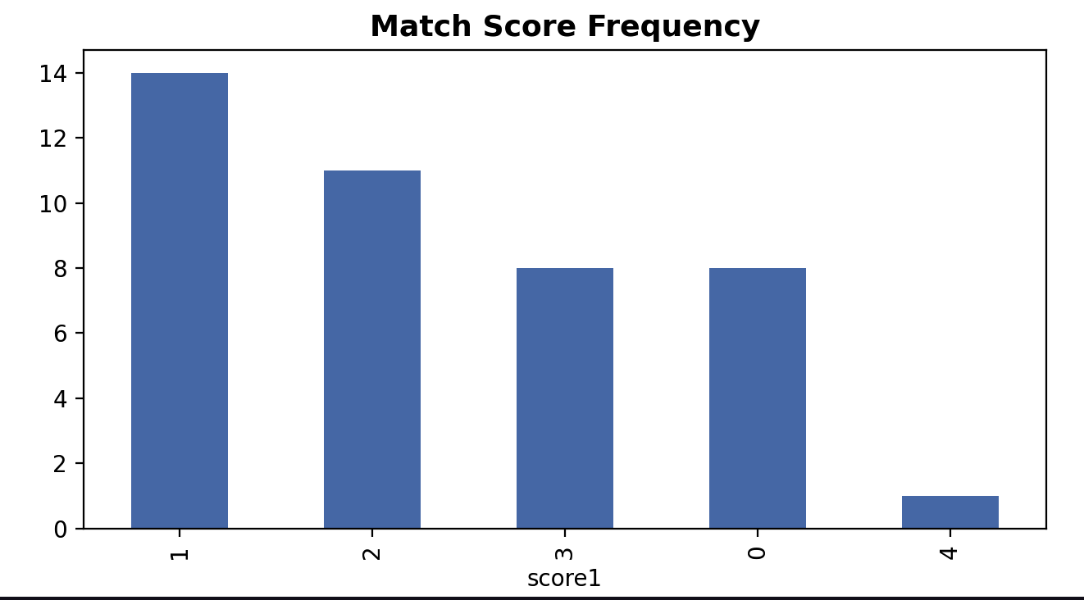
Target Value Distribution

Slide 9
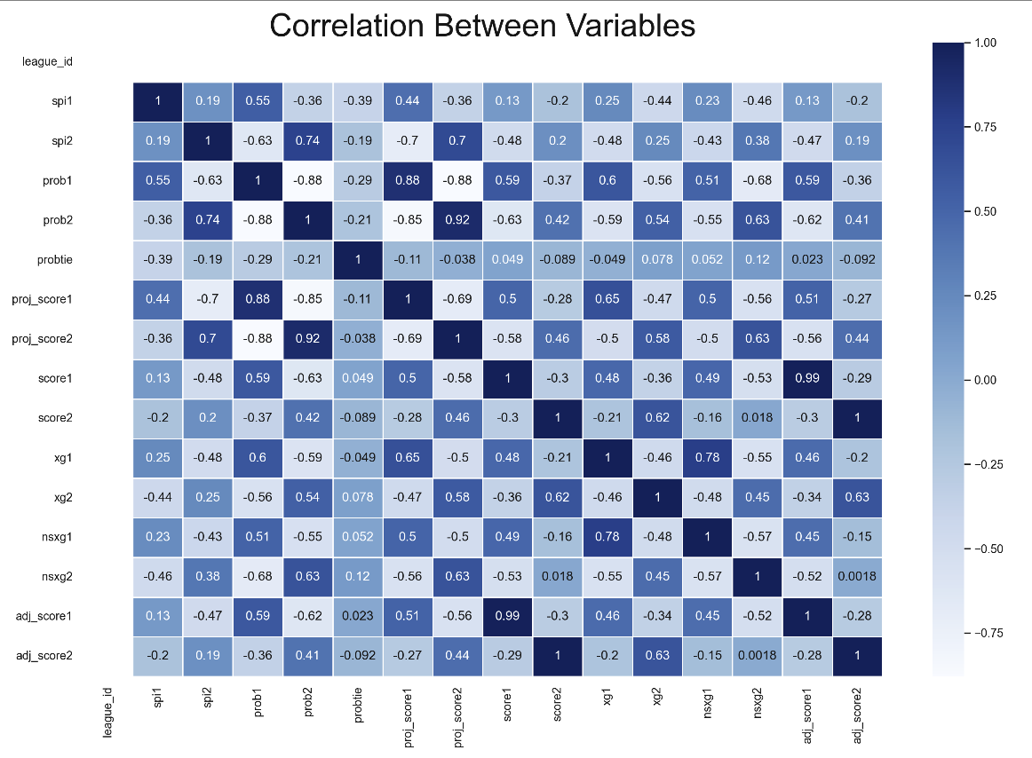
Variable Correlation

Slide 10
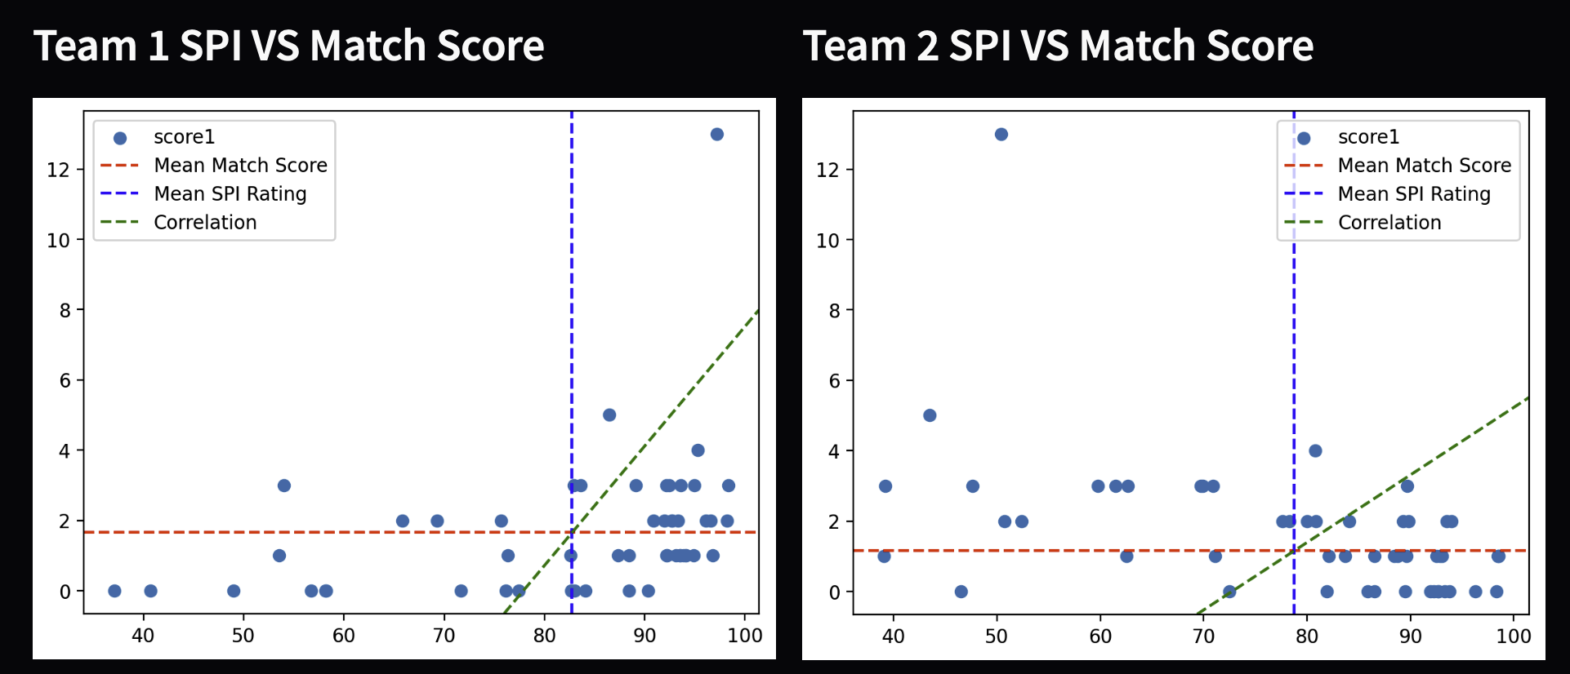
Question 1: Is there a correlation between spi and actual scores?

Slide 11
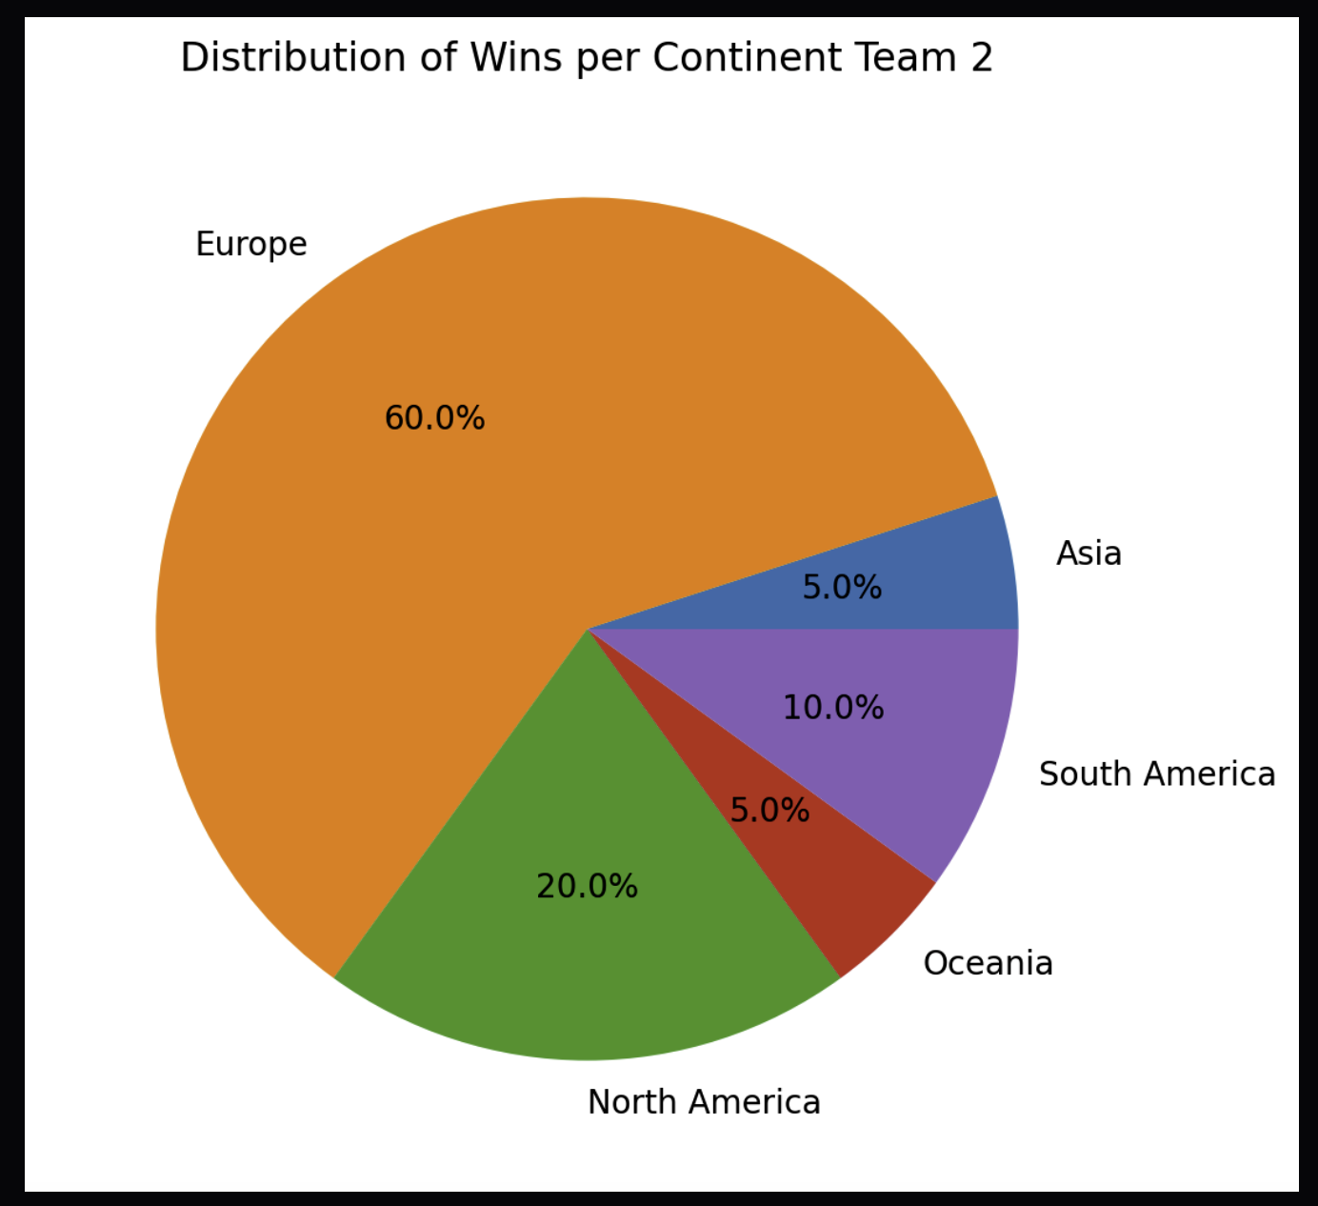
Question 2: What was the distribution of wins per continent?

Slide 12
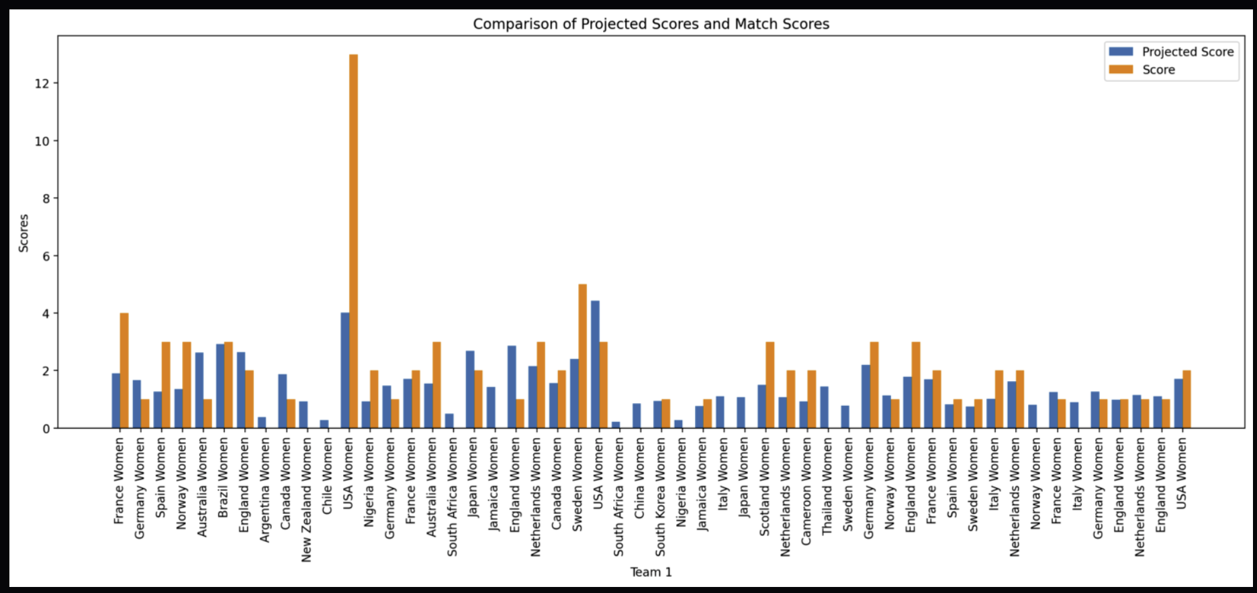
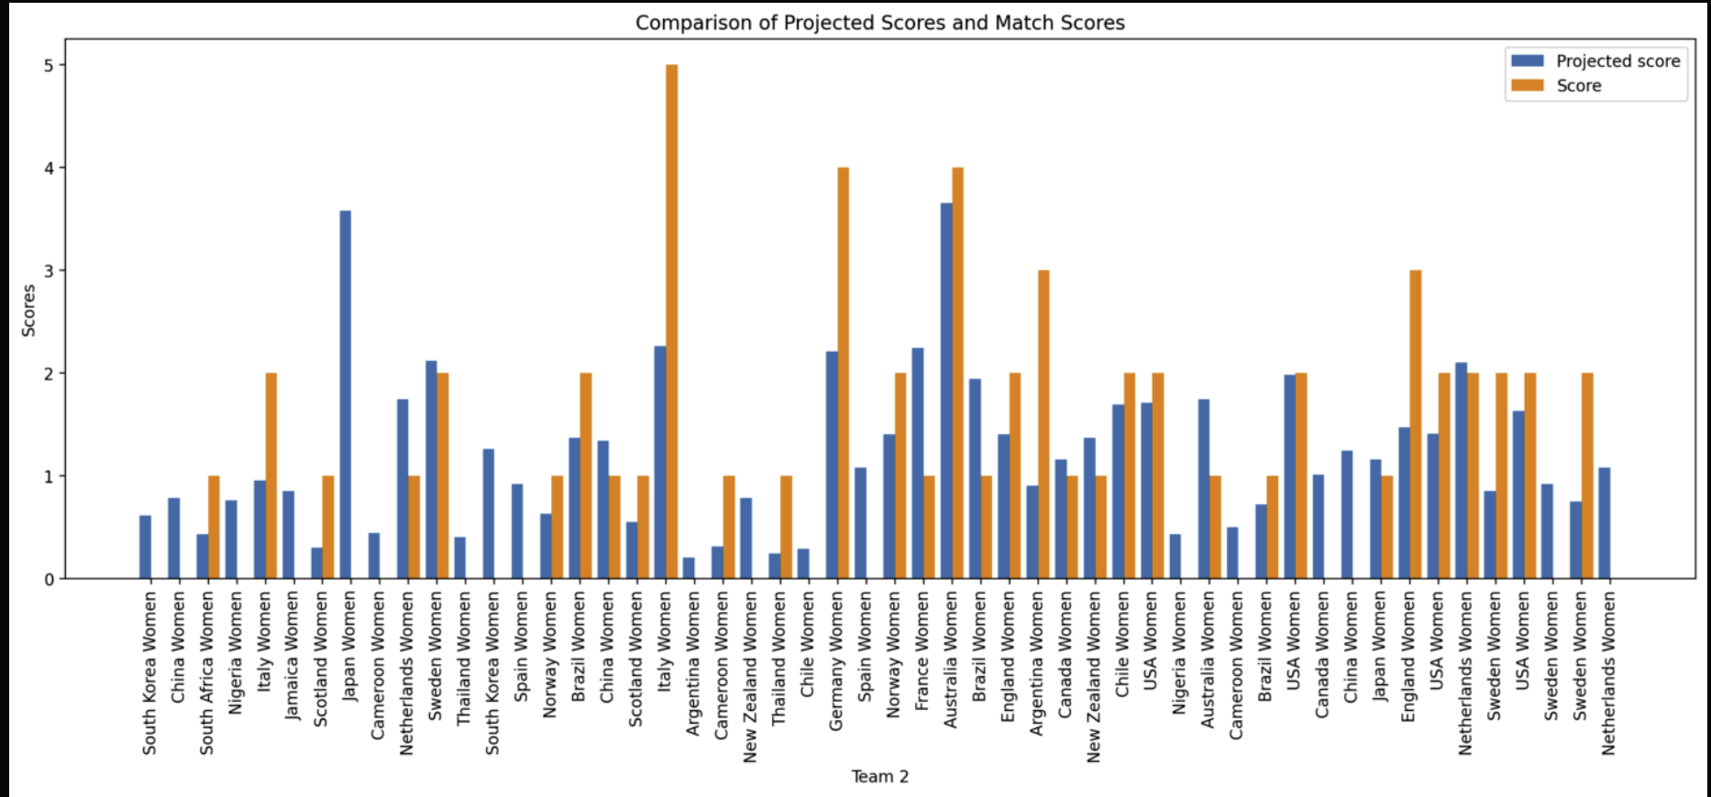
Question 3: Were the projected scores accurate?

Slide 13

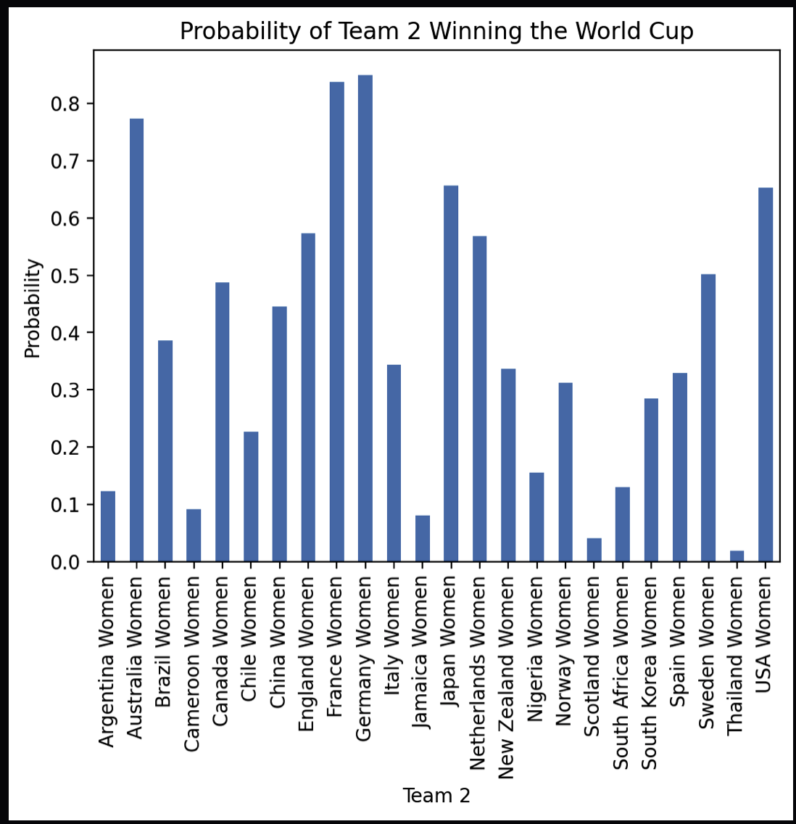
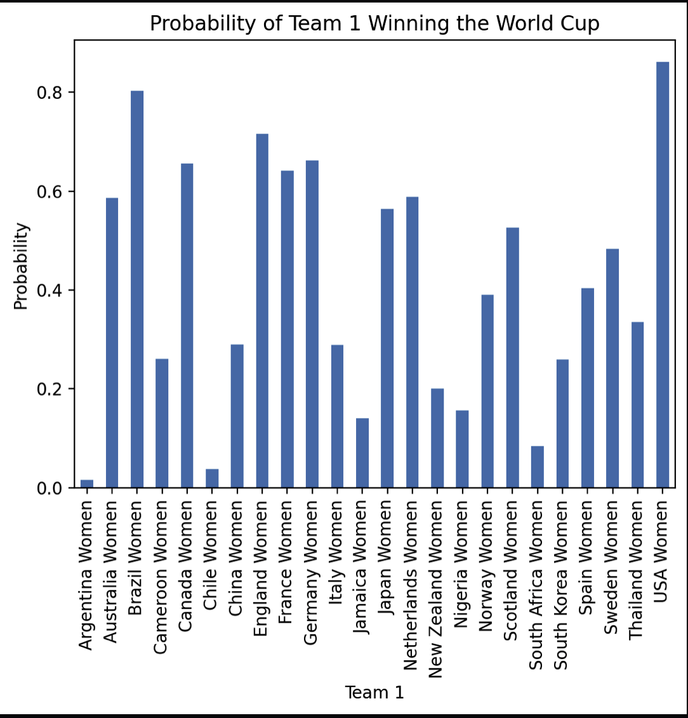
Question 4: What was the probability of each team winning the world cup?

Slide 14
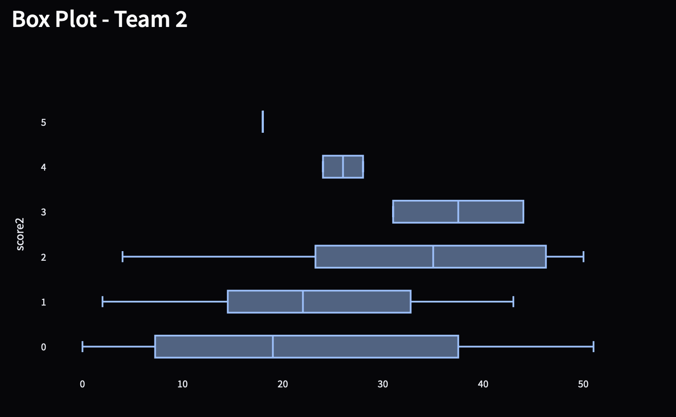
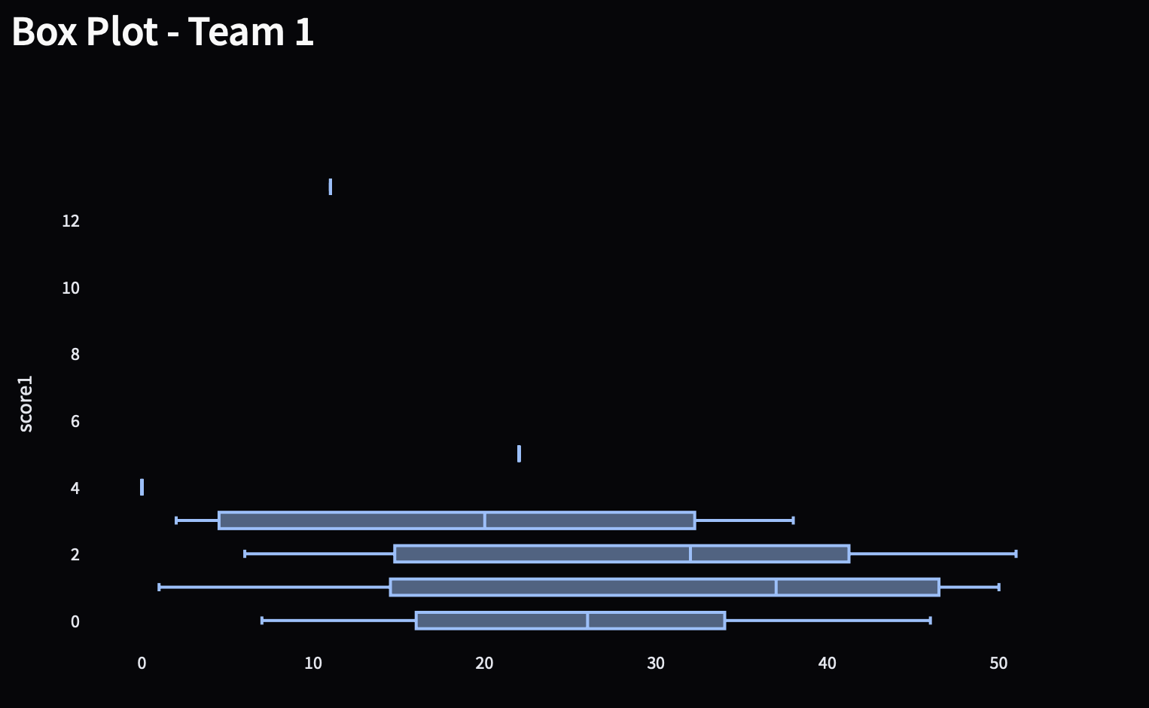
Question 5: Was the score distribution equal?

Slide 15

Predictive Data Analytics
Pre-processing of data
Target variable selection and splitting
Model training
Model evaluation
Prediction function
Streamlit application

Slide 16

Libraries
Streamlit
Pandas
Numpy
Seaborn
Matplotlib
plotlyexpress

Slide 17
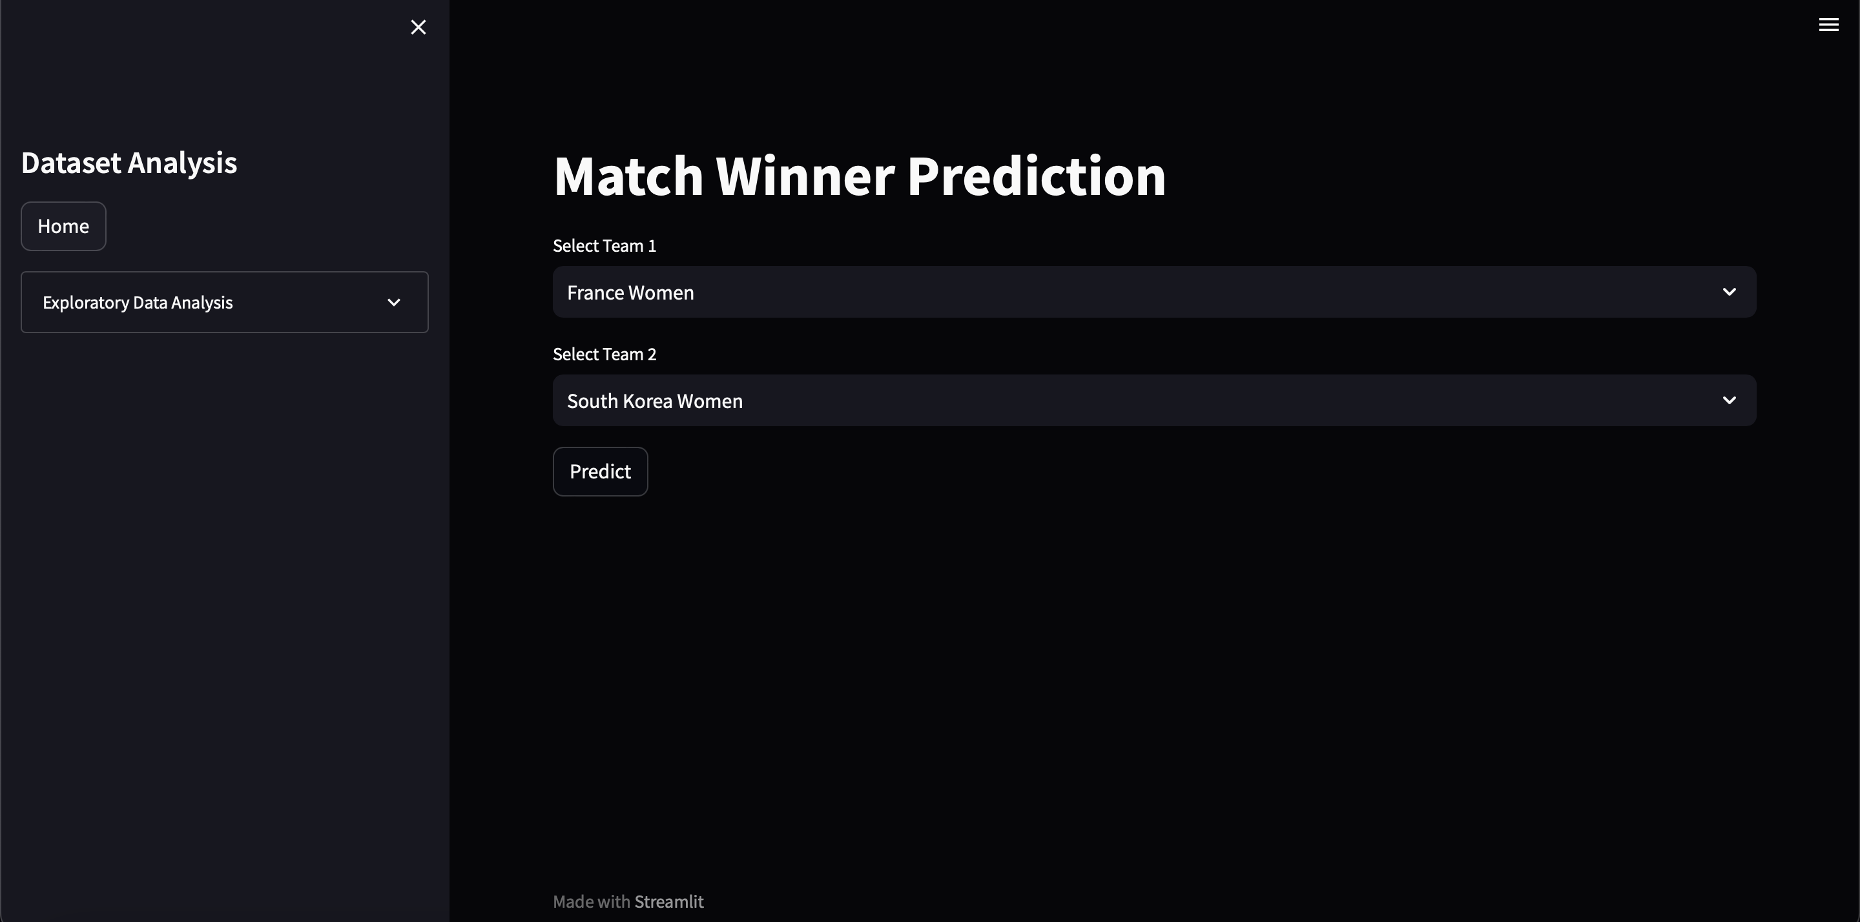
Implementation and Deployment

Slide 18
Boice, J. et al. (2019) 2019 Women’s World Cup predictions, FiveThirtyEight. Available at: https://projects.fivethirtyeight.com/2019-womens-world-cup-predictions/ (Accessed: 16 August 2023).
The Scipy Developers (2016) Scipy.stats.pearsonr, scipy.stats.pearsonr - SciPy v1.11.1 Manual. Available at: https://docs.scipy.org/doc/scipy/reference/generated/scipy.stats.pearsonr.html (Accessed: 16 August 2023).
The Matplotlib development team (2012) Matplotlib.axes.Axes.text, matplotlib.axes.Axes.text - Matplotlib 3.7.2 documentation. Available at: https://matplotlib.org/stable/api/_as_gen/matplotlib.axes.Axes.text.html (Accessed: 16 August 2023).
The Scipy Community (2016) Scipy.stats.pearsonr, scipy.stats.pearsonr - SciPy v1.11.1 Manual. Available at: https://docs.scipy.org/doc/scipy/reference/generated/scipy.stats.pearsonr.html (Accessed: 16 August 2023).
NumPy Developers (2022) Numpy.arange, numpy.arange - NumPy v1.25 Manual. Available at: https://numpy.org/doc/stable/reference/generated/numpy.arange.html (Accessed: 16 August 2023).
The Matplotlib development team (2012a) Matplotlib.axes.axes.set_xticks, matplotlib.axes.Axes.set_xticks - Matplotlib 3.7.2 documentation. Available at: https://matplotlib.org/stable/api/_as_gen/matplotlib.axes.Axes.set_xticks.html (Accessed: 16 August 2023).
The Matplotlib development team (2023) Matplotlib.axes.axes.tick_params, matplotlib.axes.Axes.tick_params - Matplotlib 3.7.2 documentation. Available at: https://matplotlib.org/stable/api/_as_gen/matplotlib.axes.Axes.tick_params.html (Accessed: 16 August 2023).
The Matplotlib development team (2023a) Matplotlib.axes.axes.legend, matplotlib.axes.Axes.legend - Matplotlib 3.7.2 documentation. Available at: https://matplotlib.org/stable/api/_as_gen/matplotlib.axes.Axes.legend.html (Accessed: 16 August 2023).
P. (2023) Box Plots using Plotly, Box plots in Python. Available at: https://plotly.com/python/box-plots/ (Accessed: 16 August 2023).
Waskom, M. (2022) Visualizing distributions of data#, Visualizing distributions of data - seaborn 0.12.2 documentation. Available at: https://seaborn.pydata.org/tutorial/distributions.html (Accessed: 18 August 2023).
References

